Slide 2
Classical Ciphers
Plaintext is viewed as a sequence of elements (e.g., bits or characters)
Substitution cipher: replacing each element of the plaintext with another element.
Transposition (or permutation) cipher: rearranging the order of the elements of the plaintext.
Product cipher: using multiple stages of substitutions and transpositions

Slide 3
Caesar Cipher
Earliest known substitution cipher
Invented by Julius Caesar
Each letter is replaced by the letter three positions further down the alphabet.
  Plain: a b c d e f g h i j k l m n o p q r s t u v w x y z
  Cipher: D E F G H I J K L M N O P Q R S T U V W X Y Z A B C
Example: ohio state → RKLR VWDWH

Slide 4
Caesar Cipher
Mathematically, map letters to numbers:
  a, b, c, ..., x, y, z
  0, 1, 2, ..., 23, 24, 25
Then the general Caesar cipher is:
  c = E_{K}(p) = (p + k) mod 26
  p = D_{K}(c) = (c – k) mod 26
Can be generalized with any alphabet.

Slide 5
Cryptanalysis of Caesar Cipher
Key space: {0, 1, ..., 25}
Vulnerable to brute-force attacks.
E.g., break ciphertext "UNOU YZGZK“
Need to recognize it when have the plaintext
What if the plaintext is written in Swahili?

Slide 6
Monoalphabetic Substitution Cipher
Shuffle the letters and map each plaintext letter to a different random ciphertext letter:
  Plain letters: abcdefghijklmnopqrstuvwxyz
  Cipher letters: DKVQFIBJWPESCXHTMYAUOLRGZN
  Plaintext: ifwewishtoreplaceletters
  Ciphertext: WIRFRWAJUHYFTSDVFSFUUFYA
What does a key look like?

Slide 7
Monoalphabetic Cipher Security
Now we have a total of 26! = 4 x 10²⁶ keys.
With so many keys, it is secure against brute-force attacks.
But not secure against some cryptanalytic attacks.
Problem is language characteristics.

Slide 8
Language Statistics and Cryptanalysis
Human languages are not random.
Letters are not equally frequently used.
In English, E is by far the most common letter, followed by T, R, N, I, O, A, S.
Other letters like Z, J, K, Q, X are fairly rare.
There are tables of single, double & triple letter frequencies for various languages

Slide 9
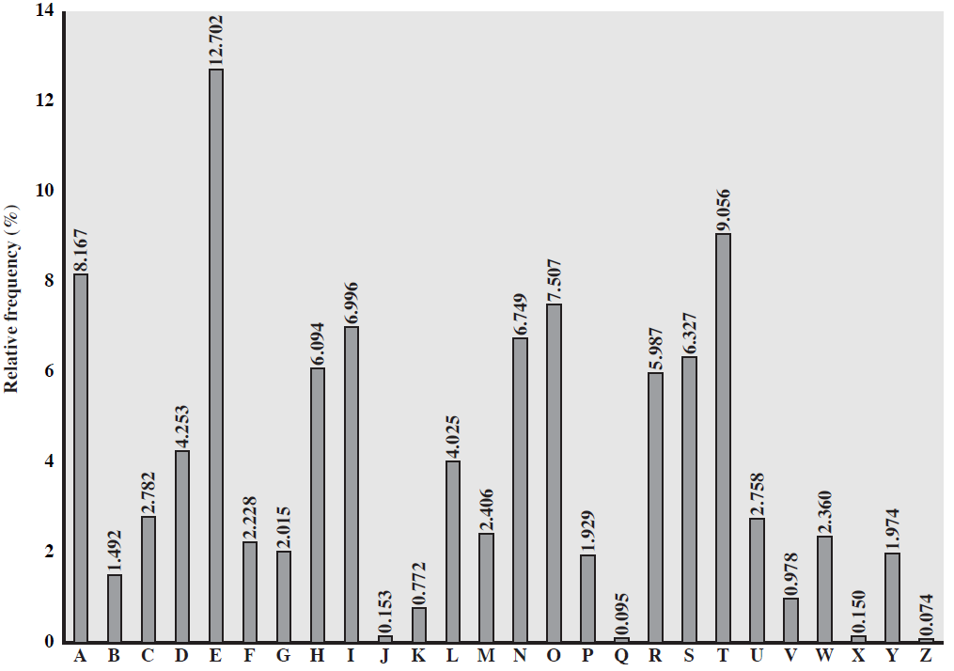
English Letter Frequencies

Slide 10
Statistics for double & triple letters
In decreasing order of frequency
Double letters:
th he an in er re es on, …
Triple letters:
the and ent ion tio for nde, …

Slide 11
Use in Cryptanalysis
Key concept: monoalphabetic substitution does not change relative letter frequencies
To attack, we
  calculate letter frequencies for ciphertext
  compare this distribution against the known one

Slide 12
Example Cryptanalysis
Given ciphertext:
  UZQSOVUOHXMOPVGPOZPEVSGZWSZOPFPESXUDBMETSXAIZ
  VUEPHZHMDZSHZOWSFPAPPDTSVPQUZWYMXUZUHSX
  EPYEPOPDZSZUFPOMBZWPFUPZHMDJUDTMOHMQ
Count relative letter frequencies (see next page)
Guess {P, Z} = {e, t}
Of double letters, ZW has highest frequency, so guess ZW = th and hence ZWP = the
Proceeding with trial and error finally get:
  it was disclosed yesterday that several informal but
  direct contacts have been made with political
  representatives of the viet cong in moscow

Slide 13
Letter frequencies in ciphertext
P 13.33 | H 5.83 | F 3.33 | B 1.67 | C 0.00
Z 11.67 | D 5.00 | W 3.33 | G 1.67 | K 0.00
S 8.33 | E 5.00 | Q 2.50 | Y 1.67 | L 0.00
U 8.33 | V 4.17 | T 2.50 | I 0.83 | N 0.00
O 7.50 | X 4.17 | A 1.67 | J 0.83 | R 0.00
M 6.67

Slide 14
What type of attack?
Ciphertext-only attack
Known-plaintext attack
Chosen-plaintext attack
Chosen-ciphertext attack

Slide 15
Playfair Cipher
Not even the large number of keys in a monoalphabetic cipher provides security.
One approach to improving security is to encrypt multiple letters at a time.
The Playfair Cipher is the best known such cipher.
Invented by Charles Wheatstone in 1854, but named after his friend Baron Playfair.

Slide 16
Playfair Key Matrix
Use a 5 x 5 matrix.
Fill in letters of the key (w/o duplicates).
Fill the rest of matrix with other letters.
E.g., key = MONARCHY.
M | O | N | A | R
C | H | Y | B | D
E | F | G | I/J | K
L | P | Q | S | T
U | V | W | X | Z

Slide 17
Encrypting and Decrypting
Plaintext is encrypted two letters at a time.
  If a pair is a repeated letter, insert filler like 'X’.
  If both letters fall in the same row, replace each with the letter to its right (circularly).
  If both letters fall in the same column, replace each with the the letter below it (circularly).
  Otherwise, each letter is replaced by the letter in the same row but in the column of the other letter of the pair.

Slide 18
Security of Playfair Cipher
Equivalent to a monoalphabetic cipher with an alphabet of 26 x 26 = 676 characters.
Security is much improved over the simple monoalphabetic cipher.
Was widely used for many decades
  eg. by US & British military in WW1 and early WW2
Once thought to be unbreakable.
Actually, it can be broken, because it still leaves some structure of plaintext intact.

Slide 19
Polyalphabetic Substitution Ciphers
A sequence of monoalphabetic ciphers (M₁, M₂, M₃, ..., M_{k}) is used in turn to encrypt letters.
A key determines which sequence of ciphers to use.
Each plaintext letter has multiple corresponding ciphertext letters.
This makes cryptanalysis harder since the letter frequency distribution will be flatter.

Slide 20
Vigenère Cipher
Simplest polyalphabetic substitution cipher
Consider the set of all Caesar ciphers:
{ C_{a}, C_{b}, C_{c}, ..., C_{z} }
Key: e.g. security
Encrypt each letter using C_{s}, C_{e}, C_{c}, C_{u}, C_{r}, C_{i}, C_{t}, C_{y} in turn.
Repeat from start after C_{y}.
Decryption simply works in reverse.

Slide 21
Example of Vigenère Cipher
Keyword: deceptive
  key: deceptivedeceptivedeceptive
  plaintext: wearediscoveredsaveyourself
  ciphertext: ZICVTWQNGRZGVTWAVZHCQYGLMGJ

Slide 22
Security of Vigenère Ciphers
There are multiple (how many?) ciphertext letters corresponding to each plaintext letter.
So, letter frequencies are obscured but not totally lost.
To break Vigenere cipher:
  Try to guess the key length. How?
  If key length is N, the cipher consists of N Caesar ciphers. Plaintext letters at positions k, N+k, 2N+k, 3N+k, etc., are encoded by the same cipher.
  Attack each individual cipher as before.

Slide 23
Guessing the Key Length
Main idea: Plaintext words separated by multiples of the key length are encoded in the same way.
In our example, if plaintext = “…thexxxxxxthe…” then “the” will be encrypted to the same ciphertext words.
So look at the ciphertext for repeated patterns.
E.g. repeated “VTW” in the previous example suggests a key length of 3 or 9:
  ciphertext: ZICVTWQNGRZGVTWAVZHCQYGLMGJ
Of course, the repetition could be a random fluke.

Slide 24
Rotor Cipher Machines
Before modern ciphers, rotor machines were most common complex ciphers in use.
Widely used in WW2.
Used a series of rotating cylinders.
Implemented a polyalphabetic substitution cipher of period K.
With 3 cylinders, K = 26³ =17,576.
With 5 cylinders, K = 26⁵ =12 x 10⁶.
What is a key?
  If the adversary has a machine
  If the adversary doesn’t have a machine

Slide 25
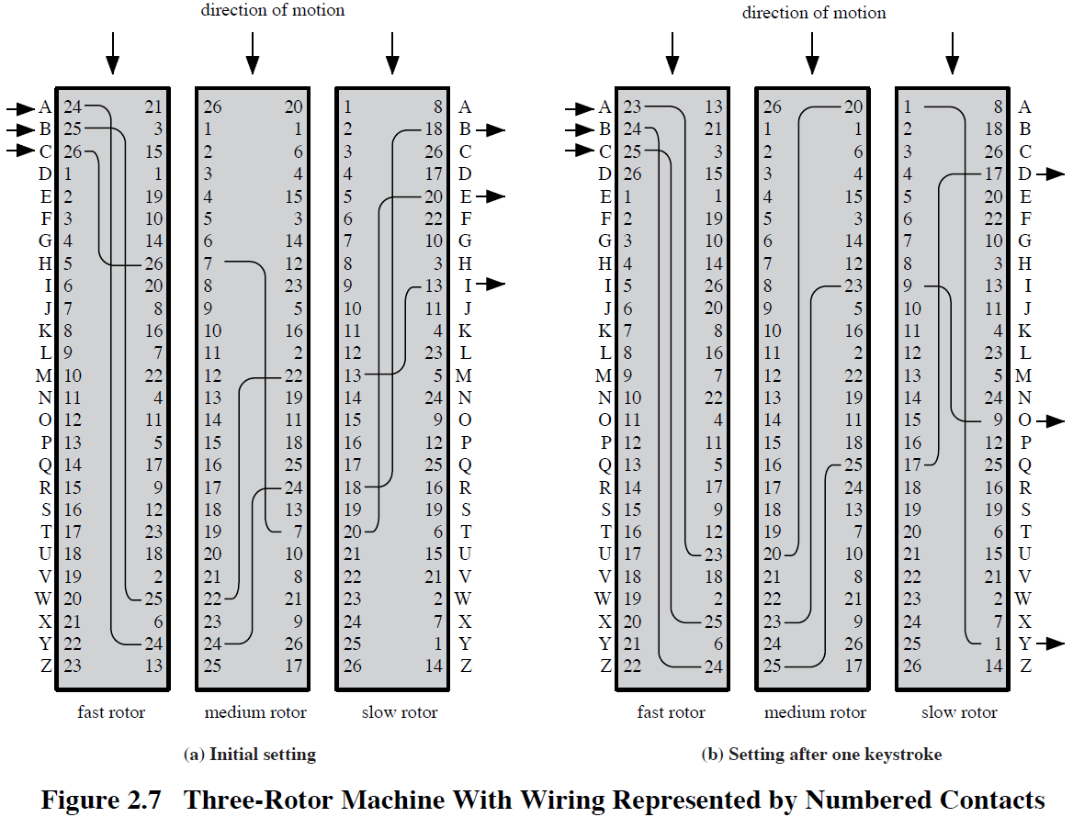

Slide 26
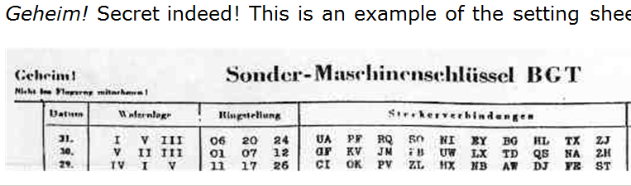
German secret setting sheets
Date
Which rotors to use (there were 10 rotors)
Ring setting
Plugboard setting

Slide 27
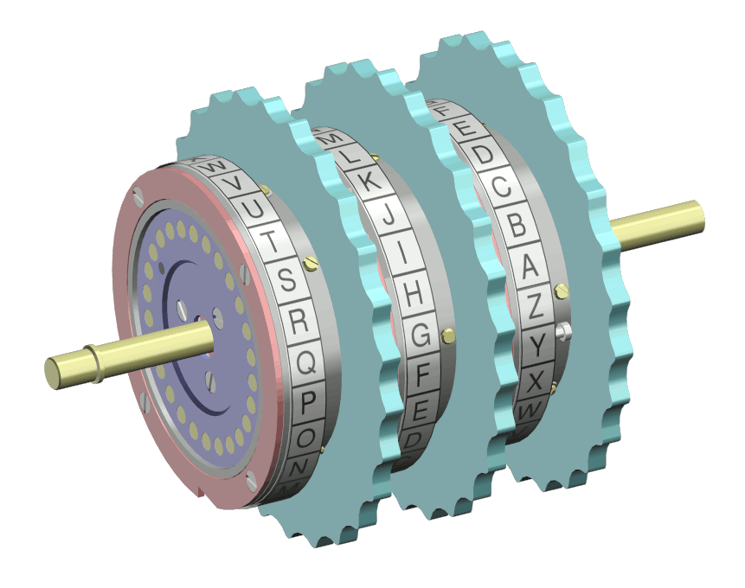
The Rotors

Slide 28
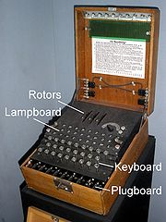
Enigma Rotor Machine

Slide 29
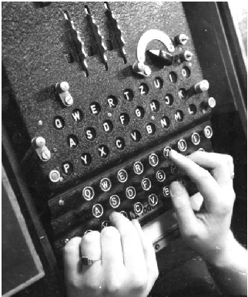
Enigma Rotor Machine

Slide 30
Transposition Ciphers
Also called permutation ciphers.
Shuffle the plaintext, without altering the actual letters used.
Example: Row Transposition Ciphers

Slide 31
Row Transposition Ciphers
Plaintext is written row by row in a rectangle.
Ciphertext: write out the columns in an order specified by a key.
  Key: 3 4 2 1 5 6 7
  Plaintext:
  Ciphertext: TTNAAPTMTSUOAODWCOIXKNLYPETZ
a | t | t | a | c | k | p
o | s | t | p | o | n | e
d | u | n | t | i | l | t
w | o | a | m | x | y | z

Slide 32
Product Ciphers
Uses a sequence of substitutions and transpositions
  Harder to break than just substitutions or transpositions
This is a bridge from classical to modern ciphers.

Slide 33
Unconditional & Computational Security
A cipher is unconditionally secure if it is secure no matter how much resources (time, space) the attacker has.
A cipher is computationally secure if the best algorithm for breaking it will require so much resources (e.g., 1000 years) that practically the cryptosystem is secure.
All the ciphers we have examined are not unconditionally secure.

Slide 34
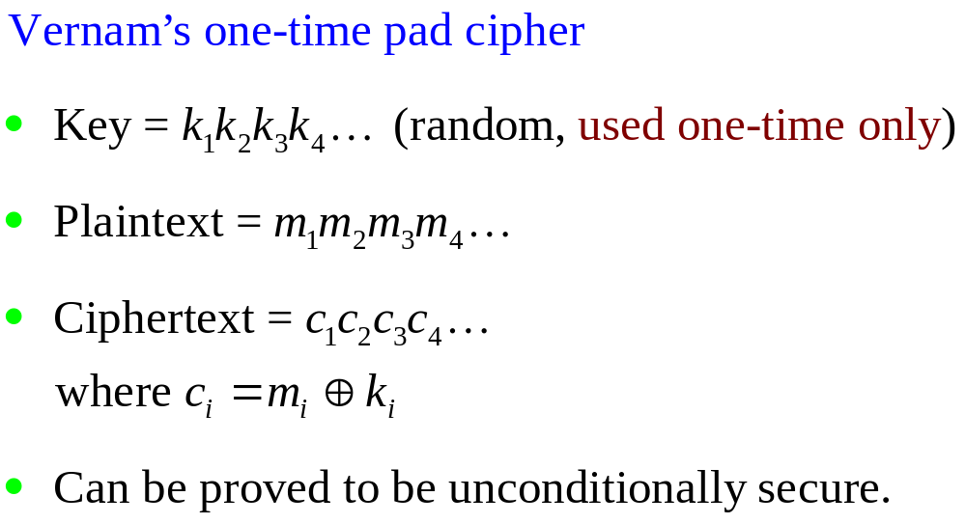
An unconditionally Secure Cipher

Slide 35
Steganography
Hide a message in another message.
E.g., hide your plaintext in a graphic image
  Each pixel has 3 bytes specifying the RGB color
  The least significant bits of pixels can be changed w/o greatly affecting the image quality
  So can hide messages in these LSBs
Advantage: hiding existence of messages
Drawback: high overhead

Slide 36
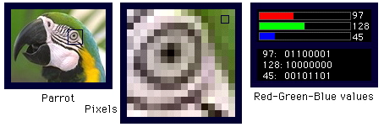
Take a 640x480 (=30,7200) pixel image.
Using only 1 LSB, can hide 115,200 characters
Using 4 LSBs, can hide 460,800 characters.

Slide 37
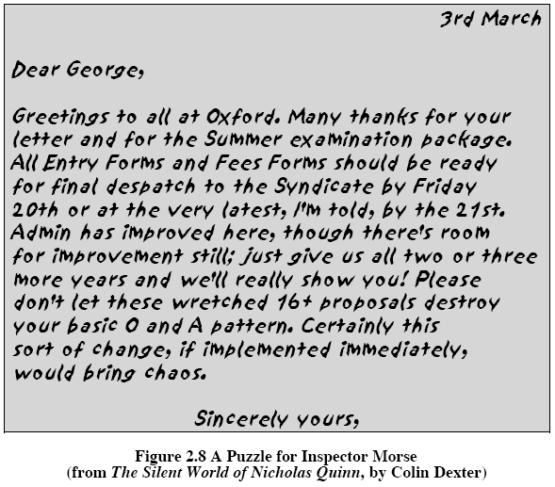

Slide 38
Summary
Have considered:
  classical cipher techniques and terminology
  monoalphabetic substitution ciphers
  cryptanalysis using letter frequencies
  Playfair cipher
  polyalphabetic ciphers
  transposition ciphers
  product ciphers and rotor machines
  stenography

